Slide 1
Arrays

Slide 2
Outline
In this lesson, we will:
Describe the limitations of variables
Introduce arrays
Describe their design and use
Consider all the consequences of using arrays

Slide 3
Limitations of parameters
To this point, we have only had the possibility of supplying either a fixed number of parameters or having a fixed number of local variables
Passing arguments to a function is expensive:
Each argument must be copied onto the call stack
Additionally, the number of parameters may vary

Slide 4
Limitations of primitive data types
Suppose we want to calculate the average of five values:
double average( double x0, double x1, double x2,
double x3, double x4 ) {
return (x0 + x1 + x2 + x3 + x4)/5.0;
}
Suppose we want to calculate the average of seven values:
double average( double x0, double x1, double x2,
double x3, double x4, double x5,
double x6 ) {
return (x0 + x1 + x2 + x3 + x4 + x5 + x6)/7.0;
}

Slide 5
Limitations of primitive data types
In some cases, we don’t know how much data we have or require:
You don’t always know how much memory will be required
Additional operations may require arbitrary amounts of additional memory
For example, your list of your favour movies may change over time:
The Good, the Bad and the Ugly
A Bridge Too Far
The Godfather Series
Lawrence of Arabia
In the Heat of the Night
The Matrix
Kill Bill
The Bridge on the River Kwai
Doctor Zhivago
Dr. Strangelove
Apocalypse Now
A Clockwork Orange
Beaufort
Forest Gump
Letters from Iwo Jima
Thomas Crown Affair (both)
The Day of the Jackal
Star Wars
On Her Majesty's Secret Service
Living Daylights
Hurt Locker
The Alien Series
Ghostbusters
The Bourne Series

Slide 6
Arrays
The logical approach is to use an approach similar to a mathematical sequence:
a₀, a₁, a₂, a₃, a₄, a₅, …, a_{n – 1}
Each entry in this sequence of n items can take on a different value
The first could be the most recent voltage reading, the next the next-most recent reading, and so on
The wiring in a circuit may have n nodes labeled 0 through n – 1
Nodal analysis allows you to find the voltages at each of the nodes

Slide 7
Arrays
We will now look at:
Array declarations
Array storage
Initializing arrays
Accessing array entries
Assigning to array entries

Slide 8
Array declarations
An array of capacity n is identified by the declaration
typename array_identifier[n];
The capacity n must be a non-negative number
The compiler allocates sufficiently many contiguous bytes to store n instances of the given datatype
Examples:
int temperatures[10]; // an array of 10 integers
double voltages[23]; // an array of 23 floating-
// point numbers

Slide 9
Array storage
An array of 10 int requires 40 bytes
Each int requires 4 bytes
int temperatures[10]; // an array of 10 integers
An array of 23 double requires 23 × 8 = 184 bytes
Each double requires 8 bytes
double voltages[23]; // an array of 23 floating-
// point numbers

Slide 10
Array entries
The entries of an array store values of the given type and may be used like local variables
The entries of
int data[4]; // an array of 4 integers
are access with
data[0] data[1] data[2] data[3]
The indices of
datatype array_name[n];
always go from 0 to n - 1

Slide 11
Array initialization
Consider this uninitialized array:
int main() {
double data[4];
std::cout << data[0] << std::endl;
std::cout << data[1] << std::endl;
std::cout << data[2] << std::endl;
std::cout << data[3] << std::endl;
return 0;
}
These two, by chance, are zero
The output is
0
0
2.0733e-317
2.0731e-317

Slide 12
Array initialization
This array has its four entries initialized:
int main() {
double data[4]{47.2, 48.3, 48.9, 49.4};
std::cout << data[0] << std::endl;
std::cout << data[1] << std::endl;
std::cout << data[2] << std::endl;
std::cout << data[3] << std::endl;
return 0;
}
The output is
47.2
48.3
48.9
49.4

Slide 13
Array initialization
If you don’t give enough initial values, the rest are set to zero:
int main() {
// Sets all entries to 0
double data[4]{};
std::cout << data[0] << std::endl;
std::cout << data[1] << std::endl;
std::cout << data[2] << std::endl;
std::cout << data[3] << std::endl;
return 0;
}
The output is
0
0
0
0

Slide 14
Array initialization
You can initialize only some of the entries:
int main() {
// Entries 2 and 3 are set to 0
double data[4]{93.5, 97.2};
std::cout << data[0] << std::endl;
std::cout << data[1] << std::endl;
std::cout << data[2] << std::endl;
std::cout << data[3] << std::endl;
return 0;
}
The output is
93.5
97.2
0
0

Slide 15
Array initialization
If you give too many, the compiler will let you know:
int main() {
// Too many initial values
double data[4]{1, 2, 3, 4, 5};
std::cout << data[0] << std::endl;
std::cout << data[1] << std::endl;
std::cout << data[2] << std::endl;
std::cout << data[3] << std::endl;
return 0;
}
example.cpp:6:33: error: too many initializers for 'double [4]'
double data[4]{1, 2, 3, 4, 5};
^

Slide 16
Array entries
If an array has four entries, those four entries can be accessed using an index from 0 to 3:
double data[4]; // an array of 4 integers
// Do something with the array...
double average{(data[0] + data[1] + data[2] + data[3])/4.0};
std::cout << "The average entry is " << average << std::endl;
We can use an array entry exactly the same as we would any other local variable or parameter of the same type
The entries of an array of bool can be used in logical expressions

Slide 17
Array entries
We can use a for-loop to step through an array:
double data[4]; // an array of 4 integers
// Do something with the array...
double maximum{data[0]};
if ( data[1] > maximum ) {
maximum = data[1];
}
if ( data[2] > maximum ) {
maximum = data[2];
}
if ( data[3] > maximum ) {
maximum = data[3];
}
std::cout << "The maximum entry is " << maximum << std::endl;

Slide 18
Array entry assignment
Each of the ten entries of this array can be assigned a value
int temperature[10]{}; // an array of 10 integers
The entries are accessed or manipulated like local variables by using an index (an integer from 0 to one less than the capacity):
temperature[0] = 32;
temperature[1] = 35;
temperature[2] = 35;
// ...
temperature[9] = 31; // 9 == (10 - 1)
The indices for an array of capacity n go from 0 to n - 1

Slide 19
Array properties
Like other local variables:
Arrays go out of scope
May or may not be initialized
An array of double is not a double
Suppose we declare:
double data[10]{};
You can use data[3] in an arithmetic expression
You cannot use data in an arithmetic expression
Suppose we declare:
bool flags[5]{};
You can use flags[2] in a logical expression
You cannot use flags in a logical expression

Slide 20
Looping through an array
Alternatively, we can loop through an array:
int main() {
double data[4]{25.23, 27.59, 28.10, 28.86};
for ( typename k{0}; k < 4; ++k ) {
std::cout << data[k] << std::endl;
}
return 0;
}
Question: what type for the index k?
int?
unsigned int?

Slide 21
Looping through an array
Problem: 'unsigned int' is 4 bytes
The largest index it can store is 2³² – 1
On a 64-bit processors, arrays can have a capacity as large as 2⁶⁴
Solution: Use 'unsigned long'?
Real solution: It depends on your processor…
Register size (bits) | Maximum array capacity | Appropriate type
64 | 2⁶⁴ | unsigned long
32 | 2³² | unsigned int
16 | 2¹⁶ | unsigned short
8 | 2⁸ | unsigned char

Slide 22
Looping through an array
Your compiler has a solution:
Your compiler is written for a specific processor
It is aware of the specifications of your processor
The standard library has a specific type just for array capacities and indices:
std::size_t
Most non-built-in types are identified with a trailing _t
std::size_t is an unsigned integer type:
On a 64-bit processor, it will be 8 bytes
On a 16-bit processor, it will be 2 bytes

Slide 23
Looping through an array
Thus, we can loop through the array as follows:
int main() {
double data[4]{25.23, 27.59, 28.10, 28.86};
for ( std::size_t k{0}; k < 4; ++k ) {
std::cout << data[k] << std::endl;
}
return 0;
}

Slide 24
Looping through an array
Here is another example:
int main() {
double data[4]{25.23, 27.59, 28.10, 28.86};
double maximum{data[0]};
for ( std::size_t k{1}; k < 4; ++k ) {
if ( data[k] > maximum ) {
maximum = data[k];
}
}
std::cout << "The maximum is " << maximum << std::endl;
return 0;
}

Slide 25
Array capacities
The array capacity need not be known at compile time:
int main();
int main() {
std::size_t capacity{};
std::cout << "Enter the number of data points: ";
std::cin >> capacity;
double data[capacity];
for ( std::size_t k{0}; k < capacity; ++k ) {
std::cout << "Enter datum #" << k << ": ";
std::cin >> data[k];
}
// Do something with the array of data
}

Slide 26
Array capacities
When declared, however, a capacity must be given:
void f() {
// 'data' is local to f()
// - it must have a specified capacity
double data[];
}
example.cpp: In function 'void f()':
example.cpp:19:16: error: storage size of 'data' isn't known
double data[];
^

Slide 27
Value of an array variable
We can assign values to the entries of an array
Question: What is the value of the array itself?
What is the output of this program?
int main();
int main() {
double data[10]{};
std::cout << data << std::endl;
return 0;
}
A hexadecimal address:
0x7fff2fa3bac0

Slide 28
Value of an array variable
The “value” of an array is the address in memory where the entries of the array are stored
In this case, at address 0x7fff2fa3bac0
Each double is 8 bytes, so we can determine exactly where each entry is in memory:
0x7fff2fa3bac0 data[0]
0x7fff2fa3bac8 data[1]
0x7fff2fa3bad0 data[2]
0x7fff2fa3bad8 data[3]
0x7fff2fa3bae0 data[4]
0x7fff2fa3bae8 data[5]
0x7fff2fa3baf0 data[6]
0x7fff2fa3baf8 data[7]
0x7fff2fa3bb00 data[8]
0x7fff2fa3bb08 data[9]

Slide 29
Value of an array variable
Unlike other local variables/parameters, you cannot assign to arrays
#include <iostream>
int main();
int main() {
double pi{3.14};
double data[10];
double tmp_array[10];
pi = 3.1415926535897932; // This is okay
data = 0x0123456789abcdef;
data = tmp_array;
return 0;
}
example.cpp: In function 'int main()':
example.cpp:10:10: error: incompatible types in assignment of 'long int' to 'double [10]'
data = 0x0123456789abcdef;
^
example.cpp:11:10: error: invalid array assignment
data = tmp_array;
^

Slide 30
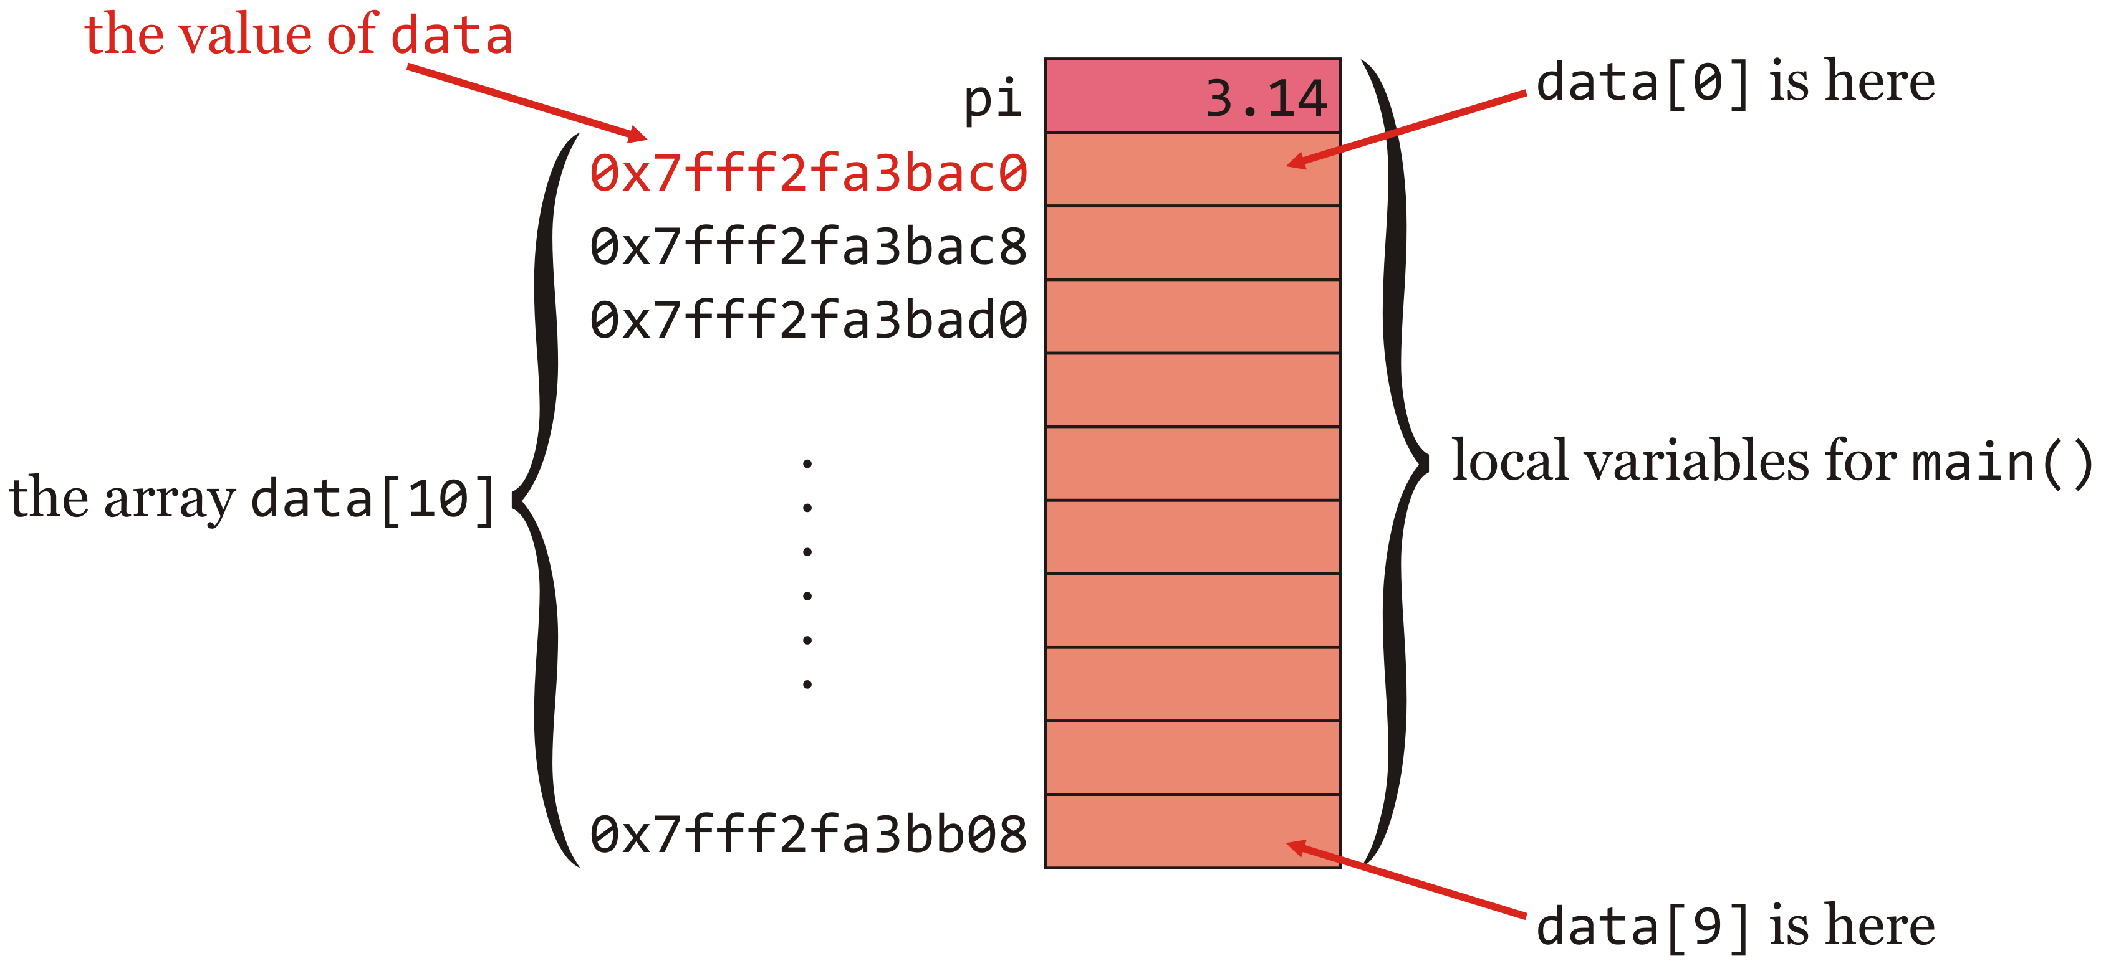
Value of an array variable
Like local variables and parameters, the memory is on the call stack:
#include <iostream>
int main();
int main() {
double data[10];
double pi{3.14};
return 0;
}

Slide 31
Arrays as parameters
When a function is called, the arguments are evaluated and copied to the locations for the parameters on the call stack
The parameters are variables restricted to the function
The arguments can be local variables, but they can also be expressions
int main() {
double x{3.14};
std::cout << std::sin( x ) << std::endl;
std::cout << std::sin( 2*x + 1 ) << std::endl;
return 0;
}

Slide 32
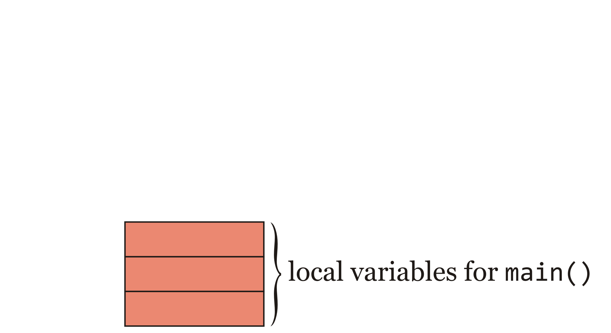
Arrays as parameters
Recalling these images:
Suppose main() has three local variables
The memory for these variables is on the stack

Slide 33
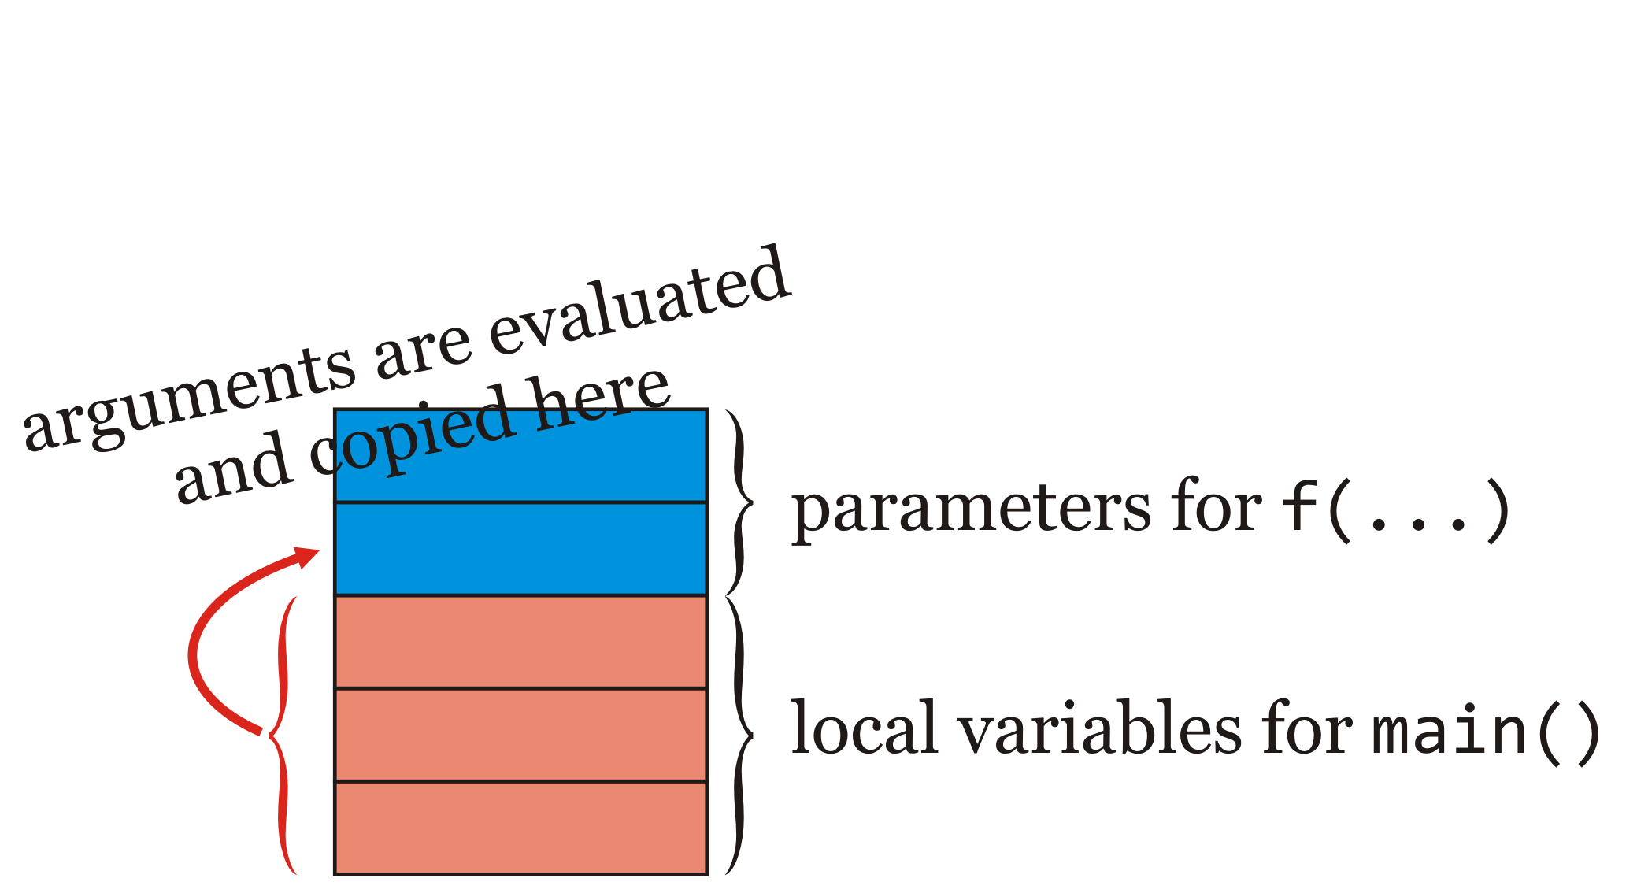
Arrays as parameters
If main() calls f(...), the arguments are evaluated and copied to the appropriate locations reserved for the parameters

Slide 34
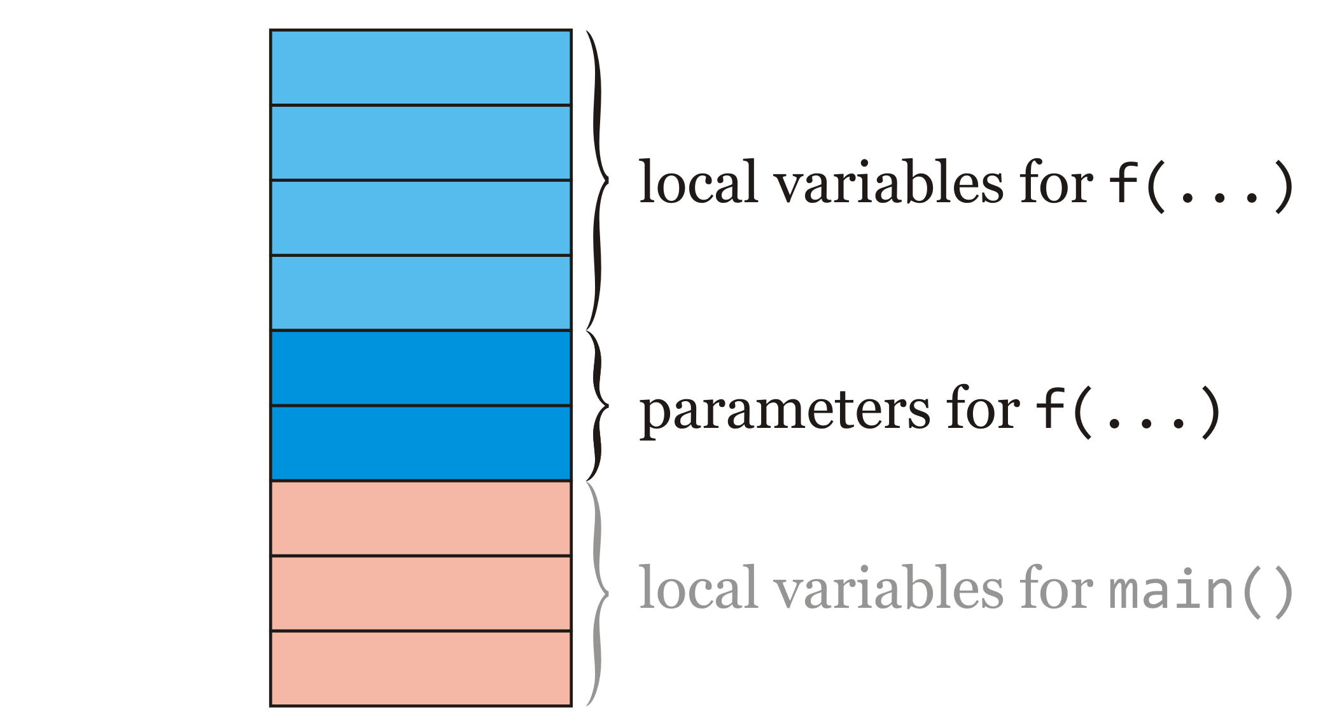
Arrays as parameters
When f(...) is called, additional space for any local variable for f(...) is also reserved on the stack
Inside f(...), you can modify the parameters and local, but when the function exists, those changes are lost

Slide 35
Arrays as parameters
We can write a function that accepts an array as a parameter
int main();
double average( double data[4] );
int main() {
// drone speed in m/s
double speeds[4]{178.2, 182.5, 187.1, 191.6};
std::cout << average( speeds ) << std::endl;
return 0;
}
double average( double data[4] ) {
double sum{0.0};
for ( std::size_t k{0}; k < 4; ++k ) {
sum += data[k];
}
return sum/4.0;
}

Slide 36
Arrays as parameters
But what is copied to the parameter?
int main();
void print_array( double array[] );
int main() {
// drone speed in m/s
double speeds[4]{178.2, 182.5, 187.1, 191.6};
std::cout << "Inside main: " << speeds << std::endl;
print_array( speeds );
return 0;
}
void print_array( double array[] ) {
std::cout << "Inside print_array: " << array << std::endl;
}
Output:
Inside main: 0x7fff3428d430
Inside print_array: 0x7fff3428d430

Slide 37
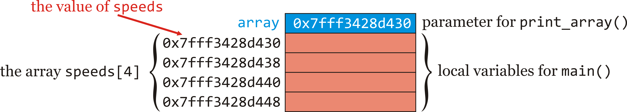
Arrays as parameters
When main() calls print_array(...), it copies the value of 'speeds' to the location of the parameter
int main() {
// drone speed in m/s
double speeds[4]{178.2, 182.5, 187.1, 191.6};
std::cout << "Inside main: " << speeds << std::endl;
print_array( speeds );
return 0;
}

Slide 38
Arrays as parameters
Problem: what if we don’t know the capacity of the array a priori?
double average( double data[4] );
double average( double data[4] ) {
double sum{0.0};
for ( std::size_t k{0}; k < 4; ++k ) {
sum += data[k];
}
return sum/4.0;
}

Slide 39
Arrays as parameters
We will accept an array of any capacity
— as long as they are double
We can separately pass the capacity:
double average( double data[], std::size_t capacity );
double average( double data[], std::size_t capacity ) {
double sum{0.0};
for ( std::size_t k{0}; k < capacity; ++k ) {
sum += data[k];
}
return sum/capacity;
}

Slide 40
Arrays as parameters
We can now call this average as follows:
int main();
double average( double data[], std::size_t capacity );
int main() {
// drone speed in m/s
double speeds[4]{178.2, 182.5, 187.1, 191.6};
std::cout << average( speeds, 4 ) << std::endl;
return 0;
}

Slide 41
Arrays as parameters
Suppose we author and then call this function:
double initialize( double array[], std::size_t capacity );
// Set all the entries of the array to 0.0
double initialize( double array[], std::size_t capacity ) {
for ( std::size_t k{0}; k < capacity; ++k ) {
array[k] = 0.0;
}
}

Slide 42
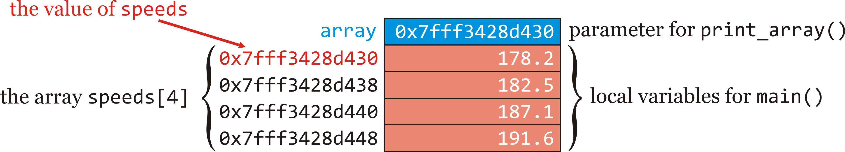
Arrays as parameters
When we call this function
int main() {
// drone speed in m/s
double speeds[4]{178.2, 182.5, 187.1, 191.6};
initialize_array( speeds, 4 );
return 0;
}
the address of the array is copied to the parameter
When inside initialize_array(...), we assign to array[0], this changes the original array entry speeds[0]

Slide 43
Arrays as parameters
Thus, the output of
// drone speed in m/s
double speeds[4]{178.2, 182.5, 187.1, 191.6};
for ( std::size_t k{0}; k < 4; ++k ) {
std::cout << "speeds[" << k << "] = " speeds[k]
<< " m/s" << std::endl;
}
std::cout << std::endl;
initialize_array( speeds, 4 );
for ( std::size_t k{0}; k < 4; ++k ) {
std::cout << "speeds[" << k << "] = " speeds[k]
<< " m/s" << std::endl;
}
Output:
speeds[0] = 178.2 m/s
speeds[1] = 182.5 m/s
speeds[2] = 187.1 m/s
speeds[3] = 191.6 m/s
speeds[0] = 0 m/s
speeds[1] = 0 m/s
speeds[2] = 0 m/s
speeds[3] = 0 m/s

Slide 44
Exceeding array bounds
The array
double data[5]{3.7, 4.0, 2.9, 8.6, 1.5};
has entries data[0] through data[4]
Problem: What will happen if you try to access or assign to data[-1] or data[5] or even data[299792458]?
Solution: It will just look in the appropriate location…
Question: What is there?
Answer: Other data including, but not limited to other local variables and other arrays

Slide 45
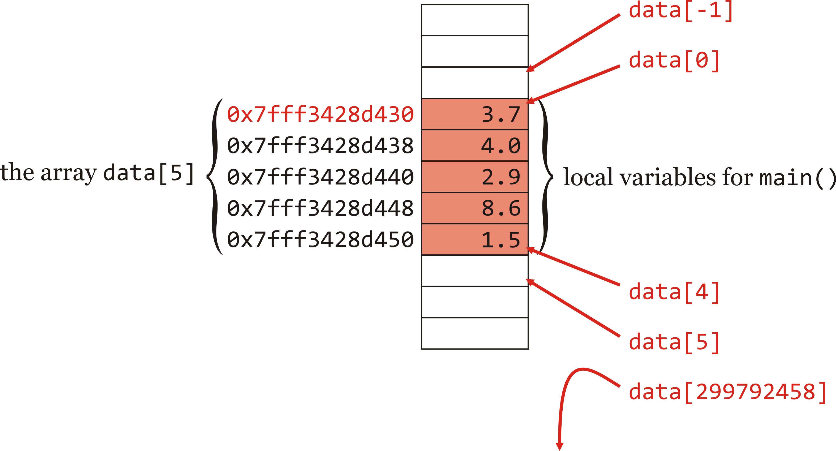
Exceeding array bounds
Well, here is the memory:
double data[5]{3.7, 4.0, 2.9, 8.6, 1.5};

Slide 46
Exceeding array bounds
int main() {
double lengths_of_beetles[5]{3.7, 4.0, 2.9, 8.6, 1.5}; // mm
int account_balances[4]{5923423, 234232, 52351, 2343232}; // cents
return 0;
}
void f() {
// 'x' is uninitialized
double x;
std::cout << "f: The unitialized local variable x = " << x << std::endl;
x = 3.14;
std::cout << "f: The assigned local variable x = " << x << std::endl;
}

Slide 47
Exceeding array bounds
int main() {
double data[5]{3.7, 4.0, 2.9, 8.6, 1.5};
f();
std::cout << "main: data[-5] = " << data[-5] << std::endl;
std::cout << "main: Assigning data[-5] the value 2.71828..." << std::endl;
data[-5] = 2.71828;
f();
std::cout << "main: data[-5] = " << data[-5] << std::endl;
return 0;
}
void f() {
// 'x' is uninitialized
double x;
std::cout << "f: The unitialized local variable x = " << x << std::endl;
x = 3.14;
std::cout << "f: The assigned local variable x = " << x << std::endl;
}

Slide 48
Exceeding array bounds
The output is:
f: The unitialized local variable x = 6.9167e-310
f: The assigned local variable x = 3.14
main: data[-5] = 3.14
main: Assigning data[-5] the value 2.71828...
f: The unitialized local variable x = 2.71828
f: The assigned local variable x = 3.14
main: data[-5] = 3.14

Slide 49
Exceeding array bounds
How about this program?
#include <iostream>
int main();
int main() {
double data[10]{3.7, 4.0, 2.9, 8.6, 1.5};
std::cout << data[299792458] << std::endl;
return 0;
}
Output:
Segmentation fault (core dumped)
or some other catastrophic error…
– The program execution is terminated

Slide 50
Exceeding array bounds
The most common error:
void initialize( double array[], std::size_t capacity );
void initialize( double array[], std::size_t capacity ) {
for ( std::size_t k{1}; k <= capacity; ++k ) {
array[k] = 0.0;
}
}
Forgetting that an array of capacity 32 has entries indexed from 0 to 31 one of the most significant issues for novice programmers

Slide 51
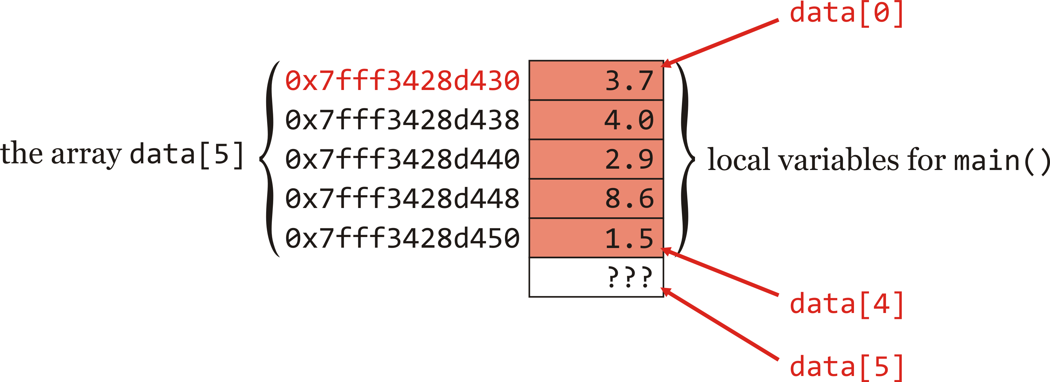
Exceeding array bounds
Given this program:
int main() {
double data[5]{3.7, 4.0, 2.9, 8.6, 1.5};
initialize( data, 5 );
return 0;
}
The initialized memory for the array data is here
We don’t know what is at data[5]

Slide 52

Exceeding array bounds
Given this program:
int main() {
double data[5]{3.7, 4.0, 2.9, 8.6, 1.5};
initialize( data, 5 );
return 0;
}
After we call initialize(...), we have:
We just overwrote something…
for ( std::size_t k{1}; k <= capacity; ++k ) {
array[k] = 0.0;
}

Slide 53
Summary
Following this lesson, you now
Understand how to declare an array as a local variable and initialize its entries
Know how to access and assign to array entries
That array entries can be treated like local variables or parameters of the same type
Arrays cannot be used in arithmetic or logical expressions
Can step through an array with a for loop
Know that array variables are assigned the address in memory where that array is stored
Understand that arrays, if passed as arguments to a function, simply pass that address
Changing an array entry of a parameter changes the argument
Access entries outside the array bounds is dangerous

Slide 54
References
[1] No references?

Slide 55



Colophon
These slides were prepared using the Georgia typeface. Mathematical equations use Times New Roman, and source code is presented using Consolas.
The photographs of lilacs in bloom appearing on the title slide and accenting the top of each other slide were taken at the Royal Botanical Gardens on May 27, 2018 by Douglas Wilhelm Harder. Please see
https://www.rbg.ca/
for more information.

Slide 56
Disclaimer
These slides are provided for the ece 150 Fundamentals of Programming course taught at the University of Waterloo. The material in it reflects the authors’ best judgment in light of the information available to them at the time of preparation. Any reliance on these course slides by any party for any other purpose are the responsibility of such parties. The authors accept no responsibility for damages, if any, suffered by any party as a result of decisions made or actions based on these course slides for any other purpose than that for which it was intended.

